Slide 1
0108

Slide 2
Visibility problem
What is the visibility problem? : 뒤에 있는 면은 보이지 않는다
Which part of obj is visible from a given viewpoint <- 얘를 결정하는 문제!
Rasterisation | Ray Tracing
비용 덜 들어간다 Screen space, NDC, Raster space Depth sorting algorithm Points are projected onto the screen to find their respective position on the image plane Point on the surface -> pixel on the image plane Object -> eye | Cost computation Slow Simulating effect (reflection, soft shadows, shading, light effect …) 픽셀의 가운데에 ray를 쏘고, ray가 obj에 맞으면, 그 obj는 해당 픽셀 위치에서 보인다고 함 Eye -> object Ray 와 object의 교점을 찾는 계산이 복잡

Slide 3
Why triangle?
Co-planar, Indivisible
Math for computing the barycentric coordinates of a triangle are simple and robust
-> texturing에 사용됨
Ray-triangle intersectin test: fast, the least memory, robust
Coding 할때 모든 geometry를 다룰 수 있게 여러 routine이 있는 것보다 하나의 방식이 있는게 더 유용하다

Slide 4
Light simulator
Reflection
Transparency
Glossy or Specular Reflection
Diffuse Reflection
Subsurface Scattering
Indirect Diffuse
Indirect Specular or Caustics
Light Transport and Shading
Global Illumination

Slide 5
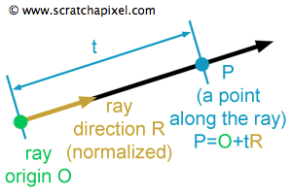
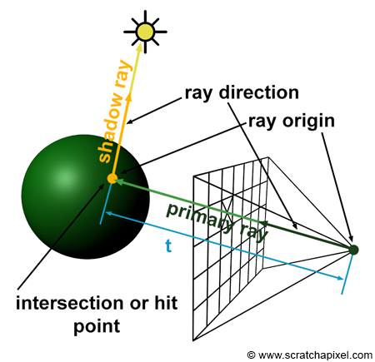
Generating Camera Rays(1)
Ray-casting : using ray-tracing to compute visibility problem
How primary rays are generated
Primary ray = camera ray : to solve visibility
Secondary ray : to compute shadows, reflections, refractions.
(shadow ray: 교점~light / reflection / refraction: 스넬의 법칙)
렌더러: to assign a color to each pixel of the frame

Slide 6
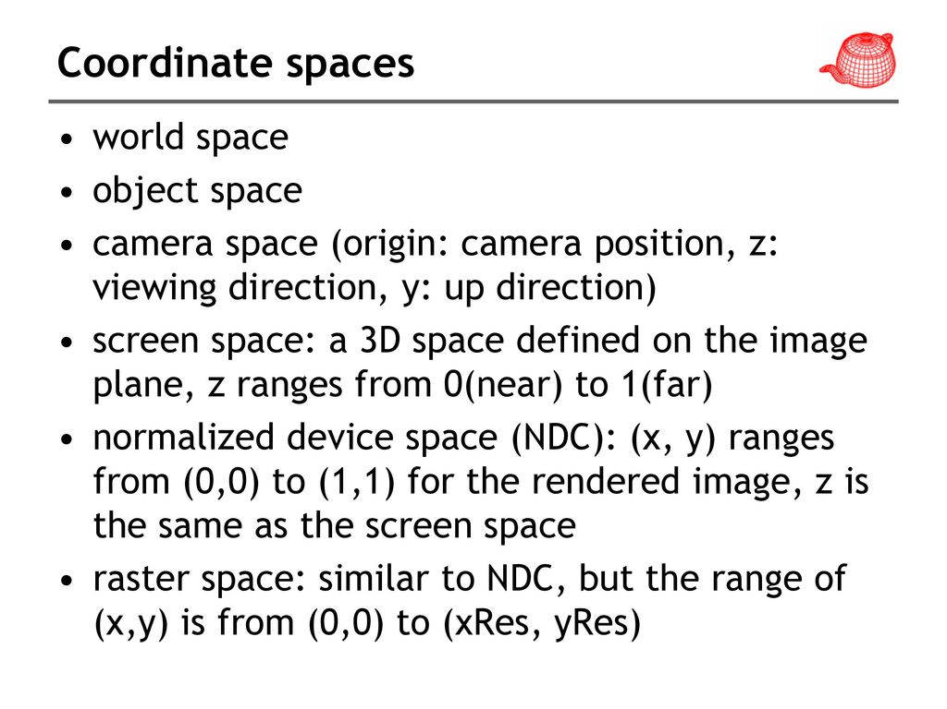
Generating Camera Rays(2)

